Slide 1

PUBLIC POLICY
Margaret Polen, Vice President for Public Policy
Certified FCL Trainer
2024

Slide 2

DIFFERENCES
Democracy
Republic
Pure Democracy

Slide 3
DEFINITION
Noun: principles on which social laws are based
Law: principle that injury to the public good is a basis for denying the legality of a contract/transaction

Slide 4
DEFINITION
Policy: made in response to an issue or problem
Policy: what the government chooses to do in actuality

Slide 5

PUBLIC vs PRIVATE
A private problem/issue becomes a public issue when it no longer affects just the individual & those immediately around that individual.
It then spills over into the wider public or society as a whole.

Slide 6
CHARACTERISTICS of PUBLIC POLICY
Courses of action not mere decisions
Goal-oriented
What government actually does

Slide 7
CHARACTERISTICS
Based upon law and is authoritative
Result of political process

Slide 8

WE AS CITIZENS NEED:
Critical Thinking
Communication Skills
Long-Term Thinking

Slide 9

NEED
Ability to work with diverse groups
Willingness to compromise

Slide 10

LIFE CYCLE of an ISSUE
Concerns
Issues Identification
Conflict

Slide 11

LIFE CYCLE
Rank Priorities
Analyze the Issue
Consider Alternative Solutions & Consequences
Make a Choice

Slide 12

LIFE CYCLE
Develop a Plan of Action
Implement the Plan
Evaluate Your Efforts

Slide 13
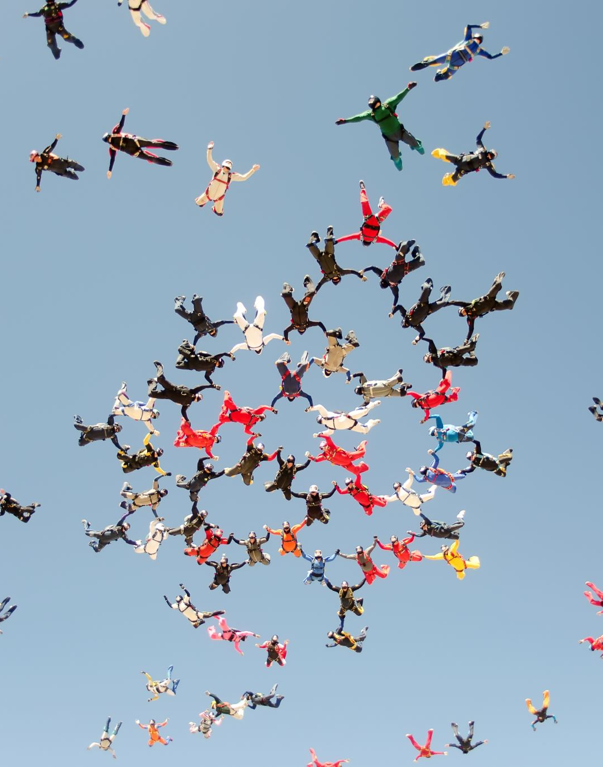
BECOMING INVOLVED
Educate Yourself
Find Your Representatives
Communicate
Participate

Slide 14
BECOMING INVOLVED
Identify Others
Be Informed
Don’t Give Up

Slide 15

WHAT CAN WE DO
SPECIFICALLY

Slide 16

AS AN INDIVIDUAL?
Stay Informed
Engage with Local Government
Join Advocacy Groups
Write Letters and Petitions

Slide 17

AS INDIVIDUALS
Network and Collaborate
Run for Office
Educate Others
Leverage Social Media

Slide 18

REACH OUT

Slide 19
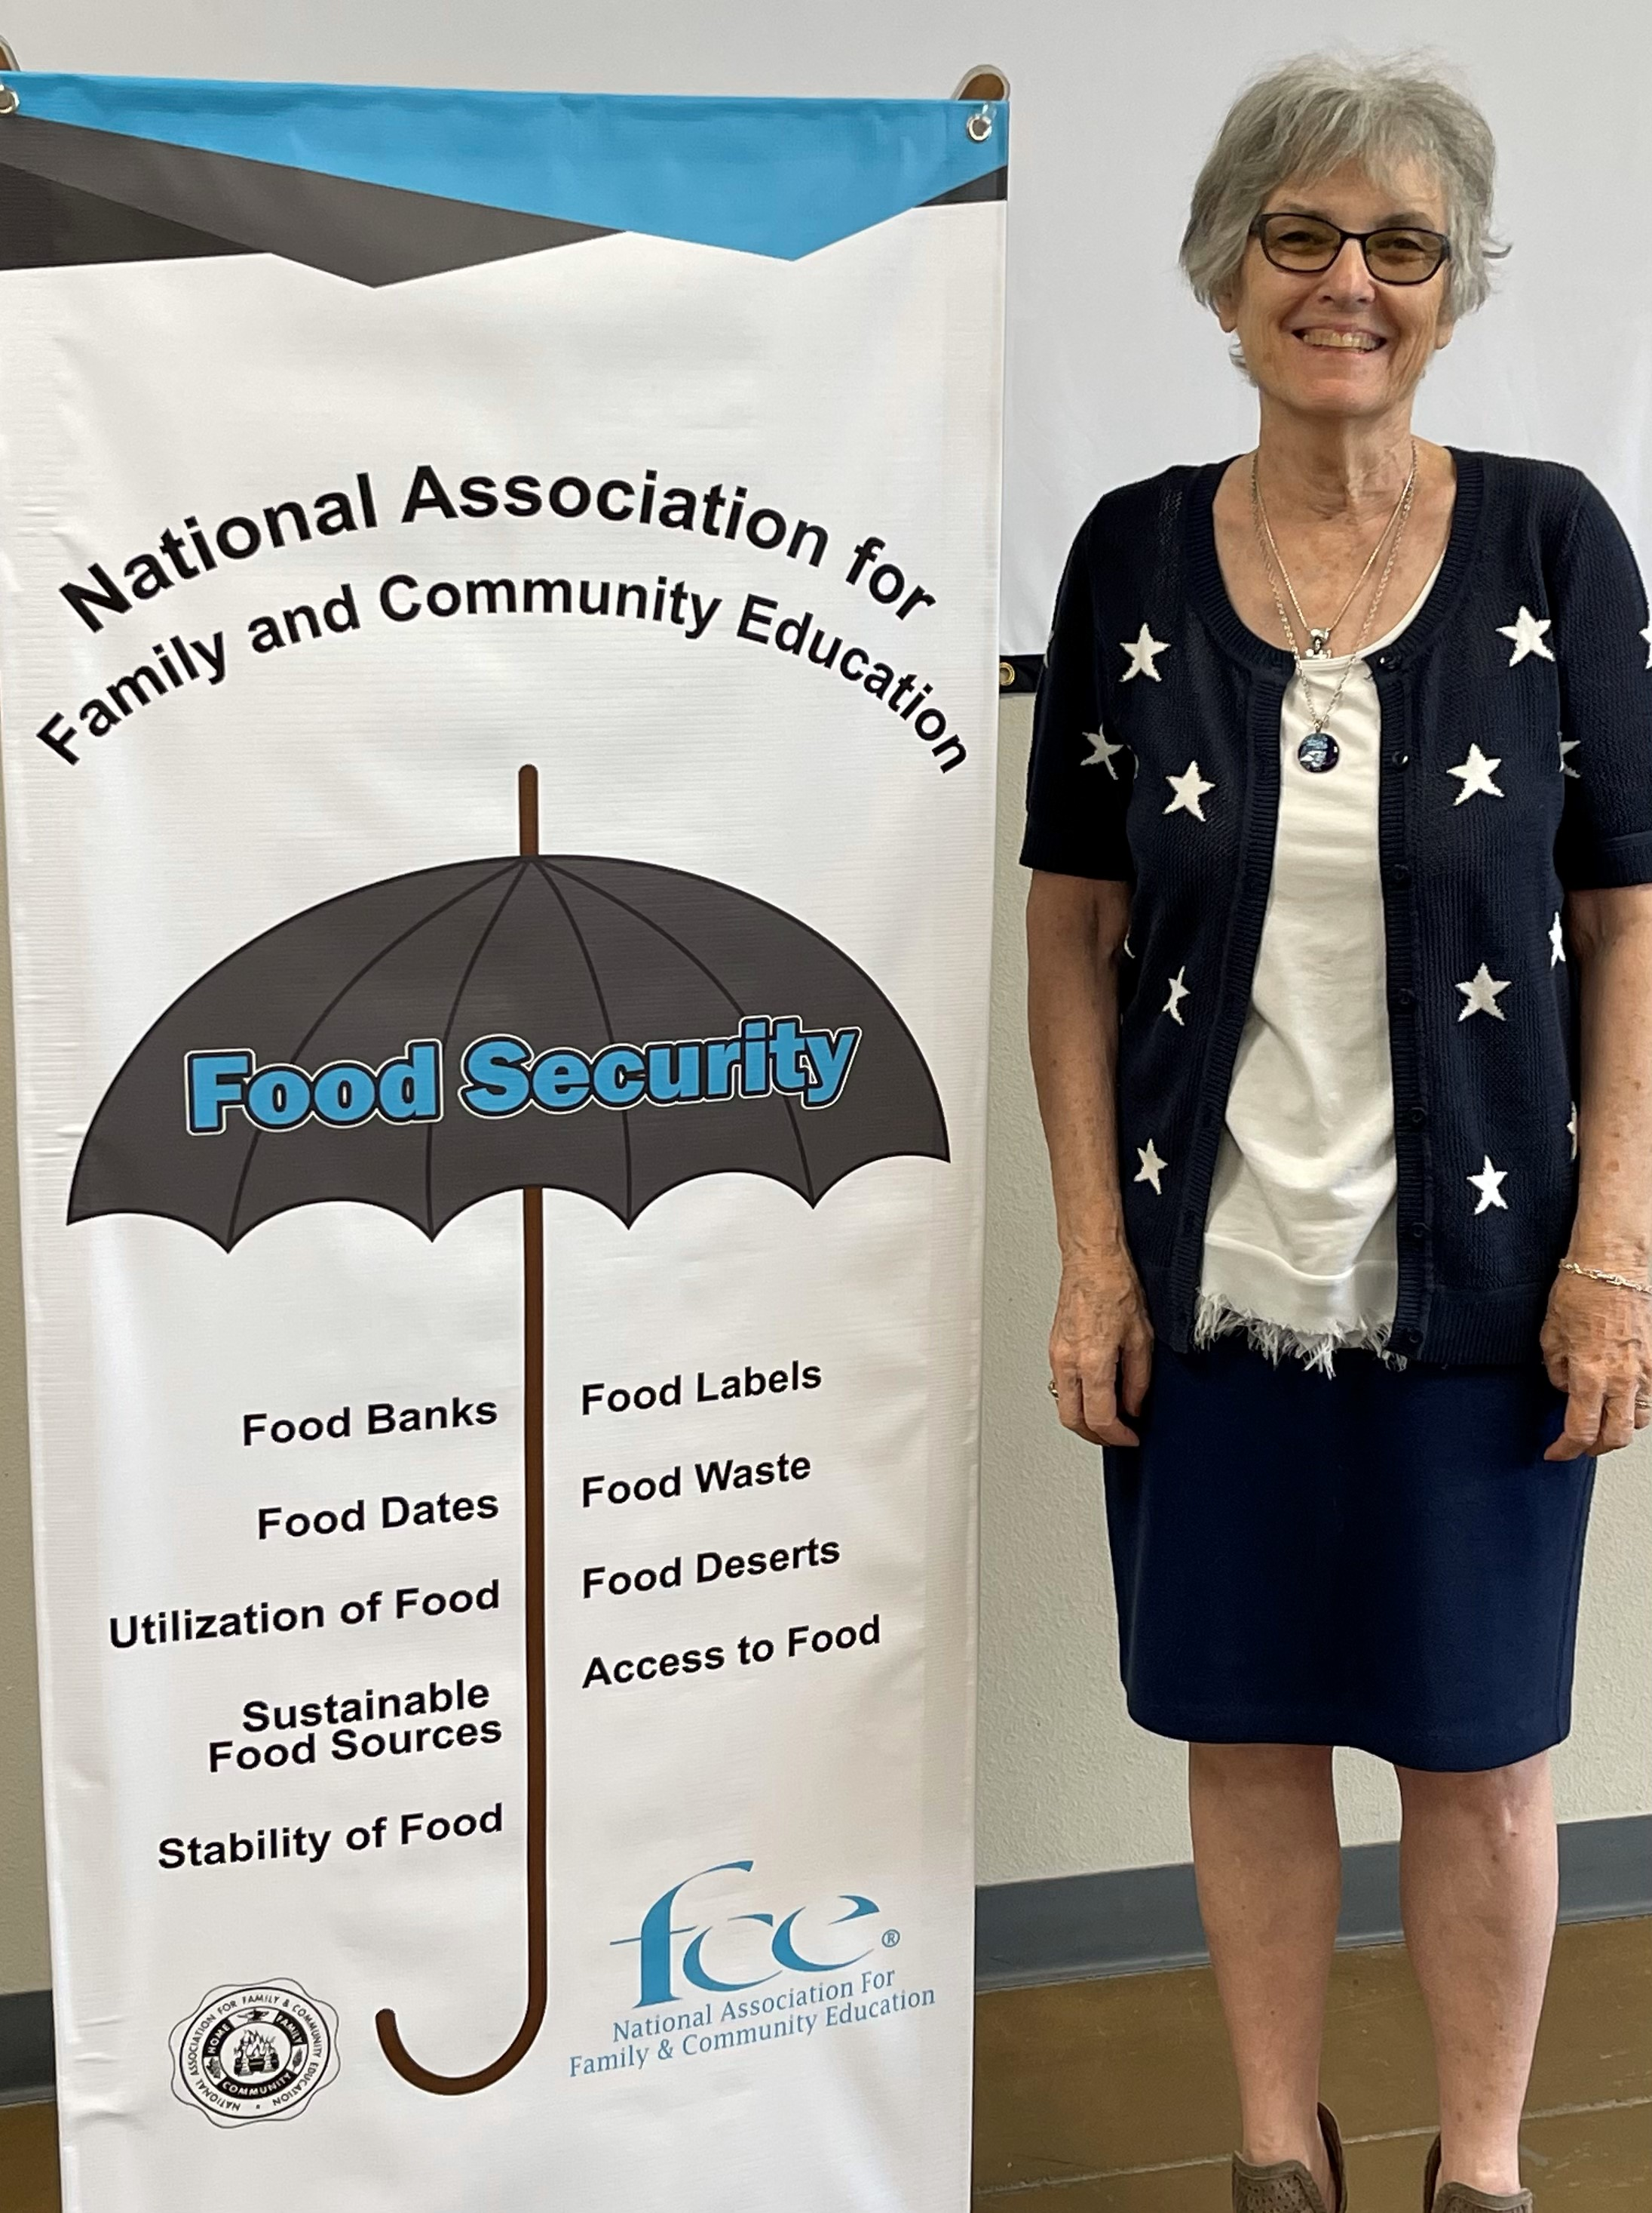

Slide 20
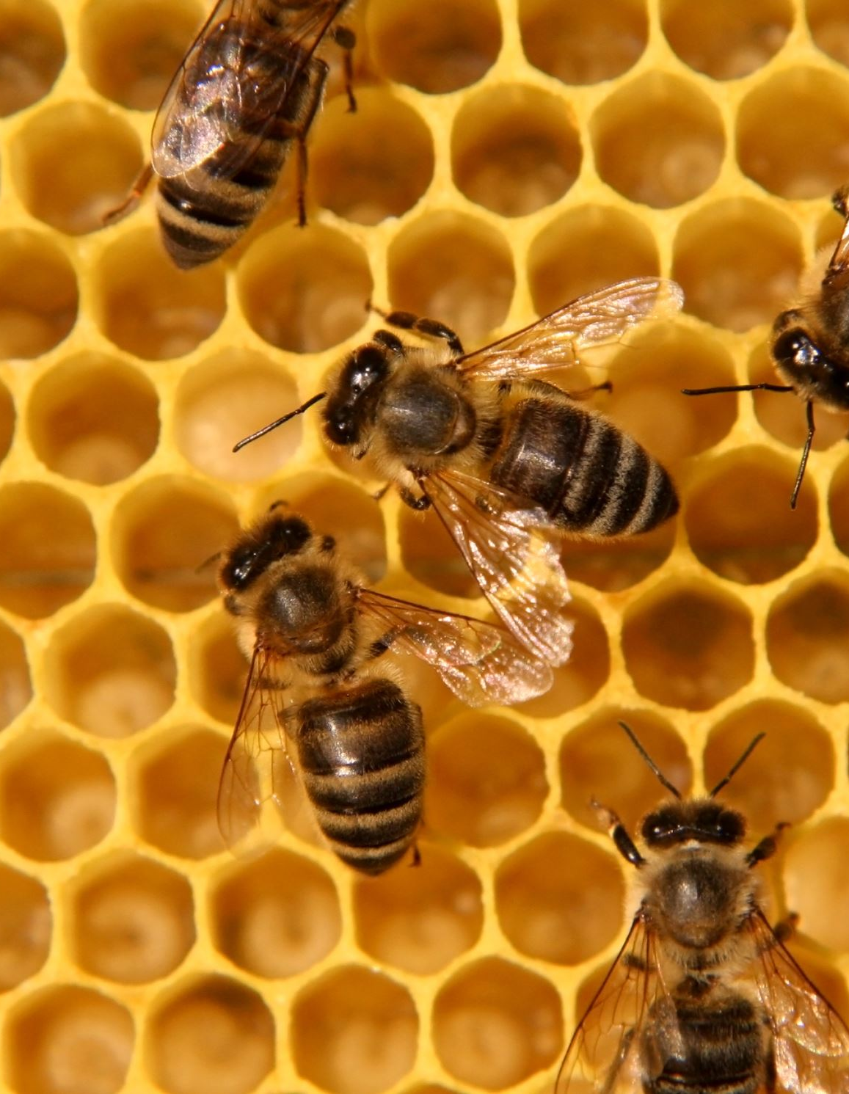
We ALL need FOOD SECURITY!
We CAN and WILL do this!

Slide 21
RESOURCES
National FCE Hearth Fires
National FCE’s FCL materials
nafce.org

