Slide 1
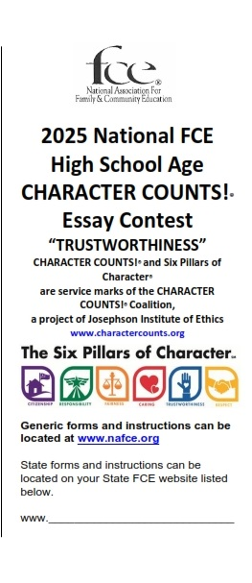

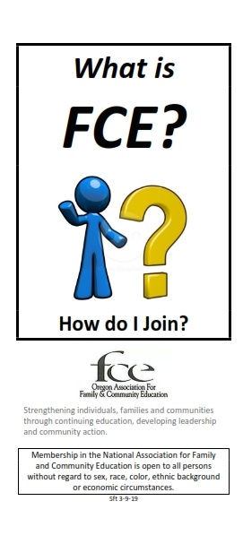


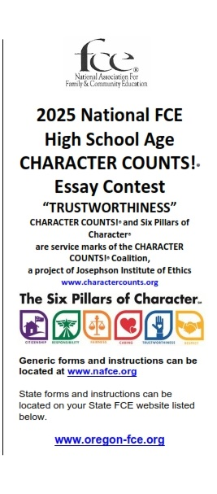
National Association for Family and Community Education
Open Brochure Contest
Presentation by Scott Teeples
Revised 8-20-26
2025 Midyear Conference Presentation

Slide 2

A brochure is a promotional document primarily used to introduce a company, organization, products, or services and inform prospective customers or members of the public of the benefits.
What is a Brochure?
2025 Midyear Conference Presentation

Slide 3

This contest is designed to be an opportunity for all National FCE members at all levels (state, districts, counties, clubs or individuals etc.) to compete in a National FCE contest. The brochure is to be a “stand-alone” item promoting FCE in some manner. The brochure does not have to be connected to a Program Award Contest. Brochures used in the
Program Award Contest may NOT be entered in this contest.
Description/Purpose of the Contest
2025 Midyear Conference Presentation

Slide 4




BROCHURES MUST PROMOTE FCE TO BE CONSIDERED FOR AWARDS
2025 Midyear Conference Presentation

Slide 5
Contestants may enter ONE (1) different brochure in each of the THREE (3) following categories:
1. FCE Marketing/Membership: These brochures are used to provide information about FCE to members of your communities and potential members. This could include recruitment information etc.
2. FCE Tools: These brochures are used as a tool in FCE to provide information needed for FCE members or those in their communities.
3. Other: These are brochures that do not fit into either of the above categories but promotes FCE in some manner.
Categories:
2025 Midyear Conference Presentation

Slide 6

This contest is open to all National FCE members, in good standing, at all levels. They may enter the contest as a state, district, county, group, unit, club or individual etc.
Open To:
2025 Midyear Conference Presentation

Slide 7

The judging will be done by the National FCE board and/or committee with the same basic scoring categories and points as used in the National FCE Program
Awards Book Brochure Contest.
Judging:
2025 Midyear Conference Presentation

Slide 8

Winners and placers in each of the three categories will receive a conference registration voucher. First place receives $100 voucher,
Second place receives a $50 voucher and
Third place receives a $25 voucher.
Awards:
2025 Midyear Conference Presentation

Slide 9

Brochures not adhering to all rules and instructions may become ineligible for awards.
The FCE logo used on the front of the brochure can be from any level of FCE including national, state, district, county, group, unit, or club etc. If the National
FCE logo is used, a license agreement must be obtained from National FCE.
Other Instructions
2025 Midyear Conference Presentation

Slide 10

Contact information, located on the back of the brochure, should include things such as the name of organization or group, addresses, phone numbers, web site addresses and other important contact information.
Each brochure contestant must email the brochure computer file or email the scanned brochure to the National FCE Headquarters and the current National FCE President on/or before April 15 of the current year. Please ask for confirmation of your email
Other Instructions (cont.)
2025 Midyear Conference Presentation

Slide 11
An option would be to bring, or send, a minimum of 30 original brochures to the National FCE Conference. These would be laid out and shared with those attending the conference in the display area OR put in the conference welcome bag.
Contestants are encouraged, but not required, to attend the National
FCE Conference.
Other Instructions (cont.)
2025 Midyear Conference Presentation

Slide 12

Read all the instructions and guidelines listed in the Open Brochure Contest
Instructions.
Review and understand the Open Brochure Judging Sheet. Read it carefully and understand each of the areas the brochure is judged on.
Make sure your brochures and entry forms are submitted via email to National FCE headquarters on/before April 15.
Important!
2025 Midyear Conference Presentation

Slide 13
All of the Open Brochure Contest forms and instructions can be found on the National FCE website www.nafce.org on the “Resource Page.”
Contact Scott Teeples (email: sfteeples@outlook.com, cell: 541-891-6456) if you need further instructions on where to find the forms and information.
Open Brochure Contest Forms
2025 Midyear Conference Presentation

Slide 14
Brochures can be developed on software programs such as WORD or PUBLISHER. All Microsoft users will have WORD on their computer, but several will not have PUBLISHER. Apple software is also available.
Basic setting on the WORD software are: 1. Landscape format; 2. Three columns; 3. Margins: Top 0.4, Bottom 0.5, Left 0.3, and Right 0.3. You may have to use other settings to fit your needs.
Basics of making a Brochure
2025 Midyear Conference Presentation

Slide 15
Make the brochure interesting. Include FCE logos, clipart, and other things to bring the brochure to life.
Don’t clutter the brochure with too many items. Don’t make the text too small or crowded.
Use some color in the brochure and have it printed in color.
Print the brochure double sided flipping on the short side.
Basics of making a Brochure (cont.)
2025 Midyear Conference Presentation

Slide 16

Include the important basis parts of the brochure and put them in their proper places. The following slides will help.
Contact Scott Teeples if you would like a WORD version of a brochure that you can edit and use. It will come formatted. You can delete and replace the information while keeping the formatting
Basics of making a Brochure (cont.)
2025 Midyear Conference Presentation

Slide 17
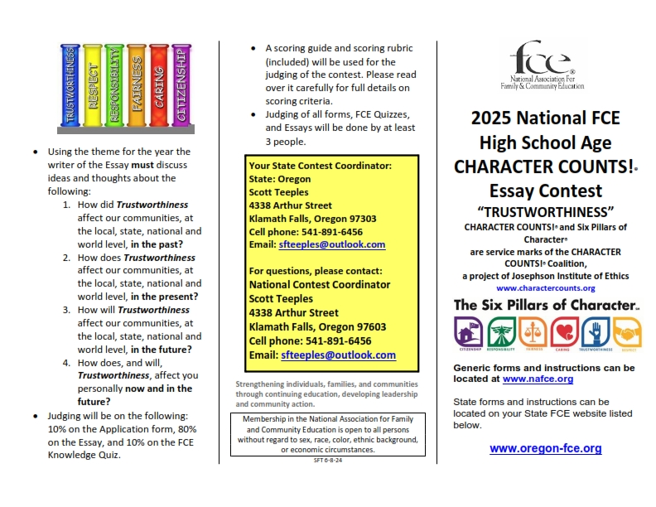
There are three sections on the front page.
What’s On Each Front Section of the Font Page? (when folded)
The Front Title Section will be on the front. It should have your title, logos, clip art, etc.
The Front Center Section will be on the back of the brochure. It should contain contact and other information.
The Front Information Section will contain information you want in your brochure. It is folded inside of the brochure.
Front Information Section
Front Center Section
Front Title Section
2025 Midyear Conference Presentation

Slide 18
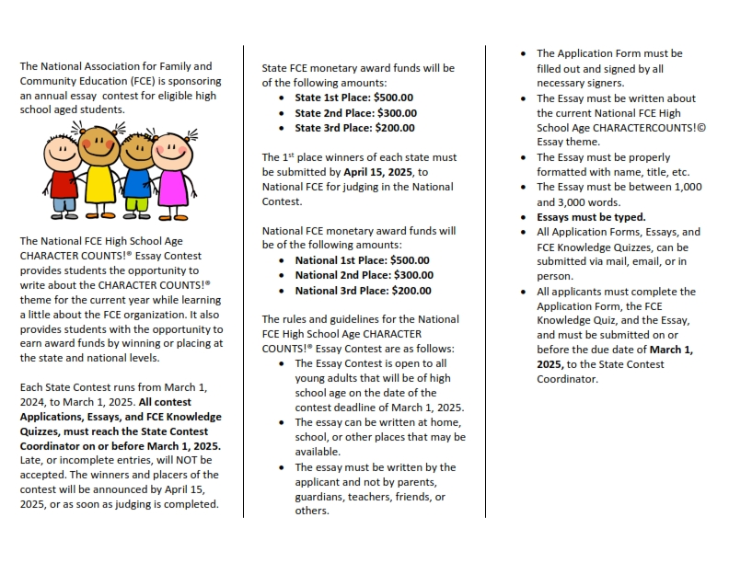
There are three sections on the back page.
Back Information Section
Back Information Section
Back Information Section
What’s On Each Back Section of the Back Page? (when folded)
The Back Information Sections will contain information you want in your brochure. They are all folded inside of the brochure.
Be sure to include some clip art and check the formatting for great appearance.
2025 Midyear Conference Presentation

Slide 19

Remember, “You can’t win if you don’t enter the Contest.” Do your best. Make a brochure that can help you with FCE. They are a wonderful tool.
Contact Scott Teeples if you need help.
“When you become better than the teacher, he/she has done their job!”
Questions or Comments?
2025 Midyear Conference Presentation

