Slide 1
Empowering Volunteers…
Treasure the Present
National Association for Family and Community Education
Annual Conference
July 25-28, 2024
Erlanger, Kentucky

Slide 2

Join Us In…

Slide 3
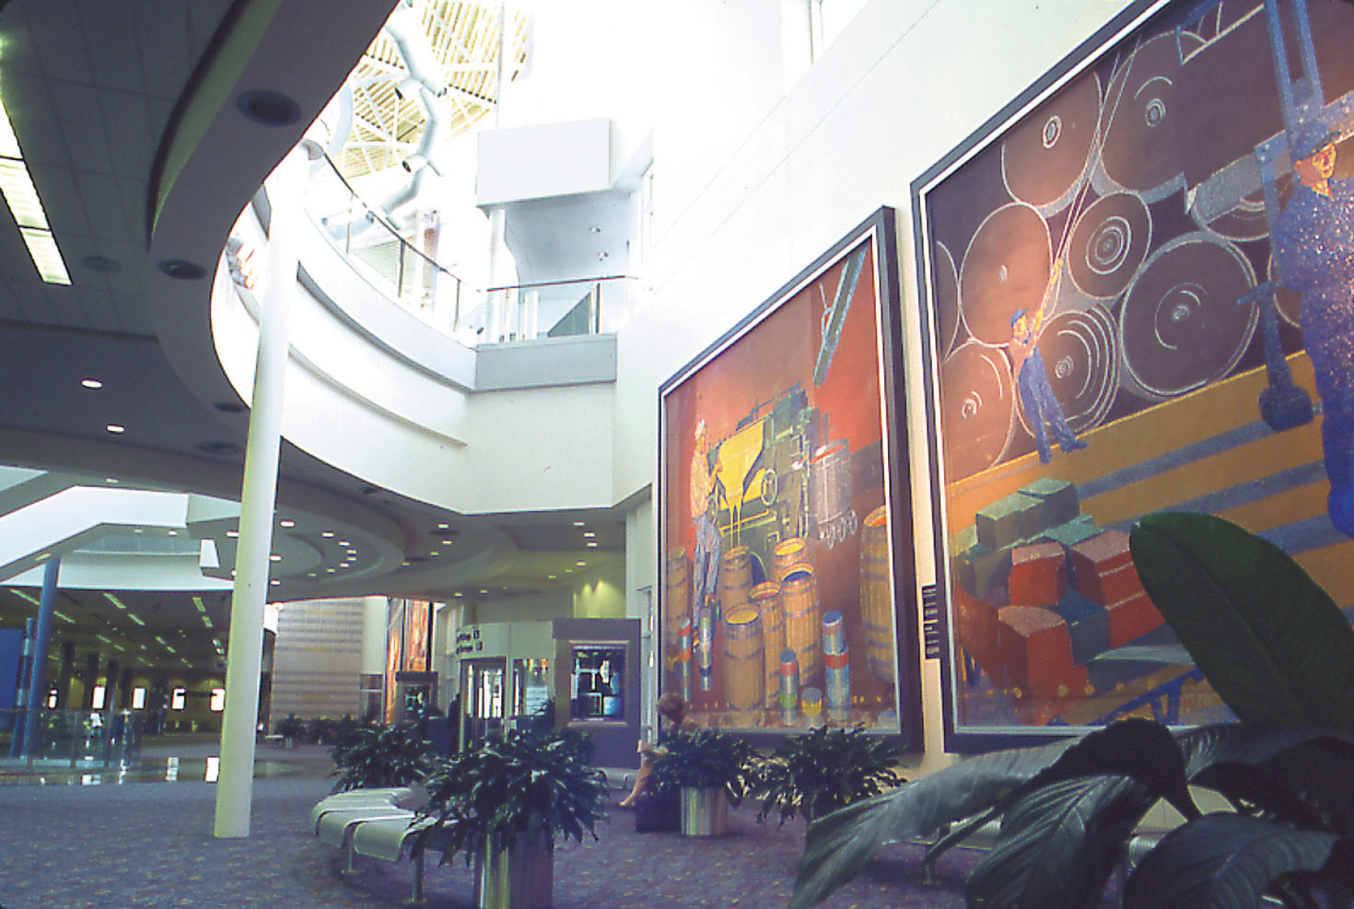
Your experience begins…

Slide 4
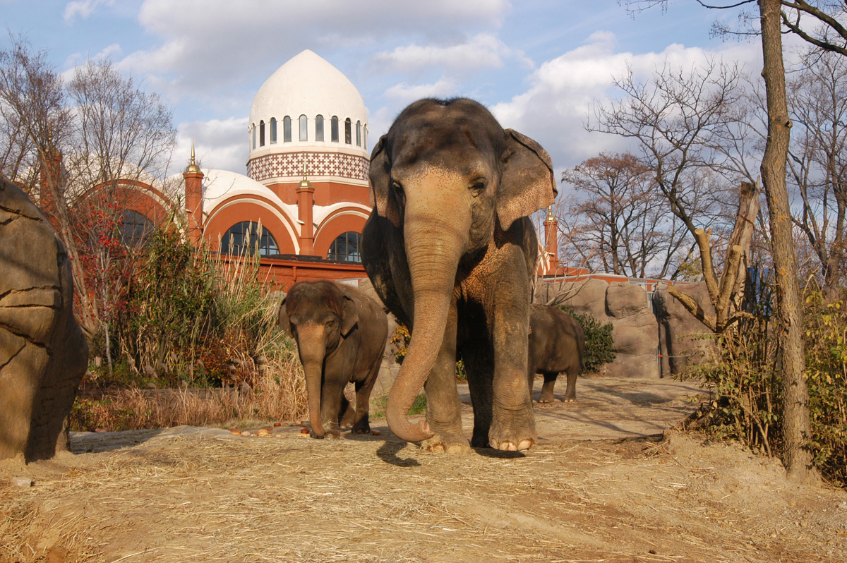
Things to see and do…

Slide 5
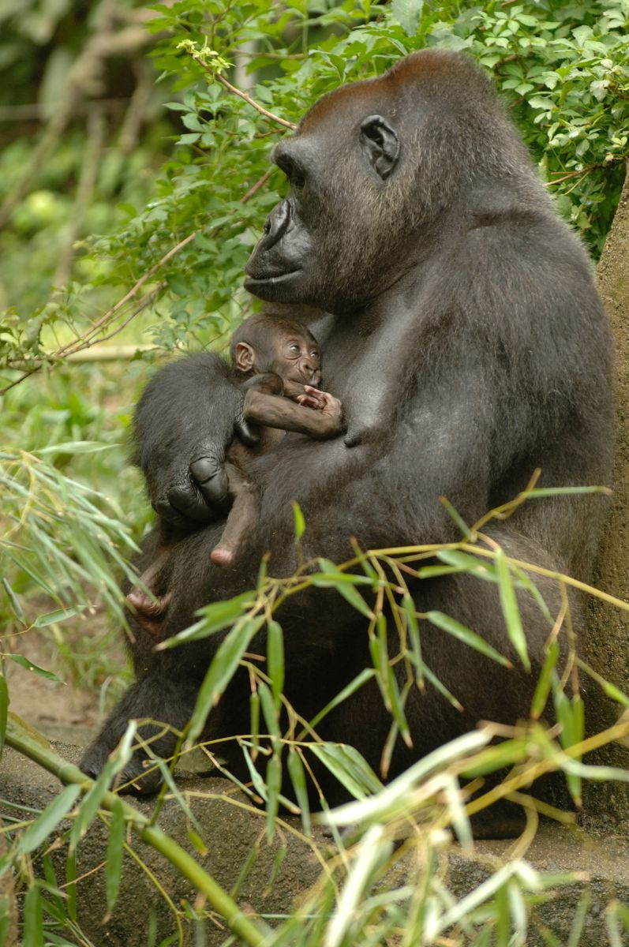
at the Zoo!!!

Slide 6
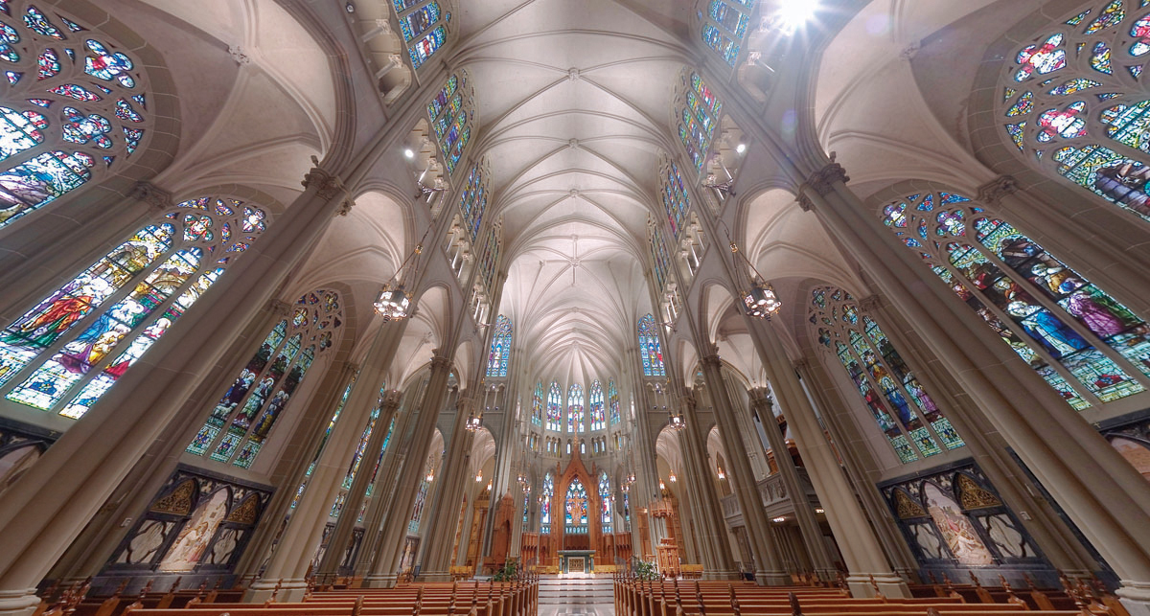
Cathedral Basilica

Slide 7
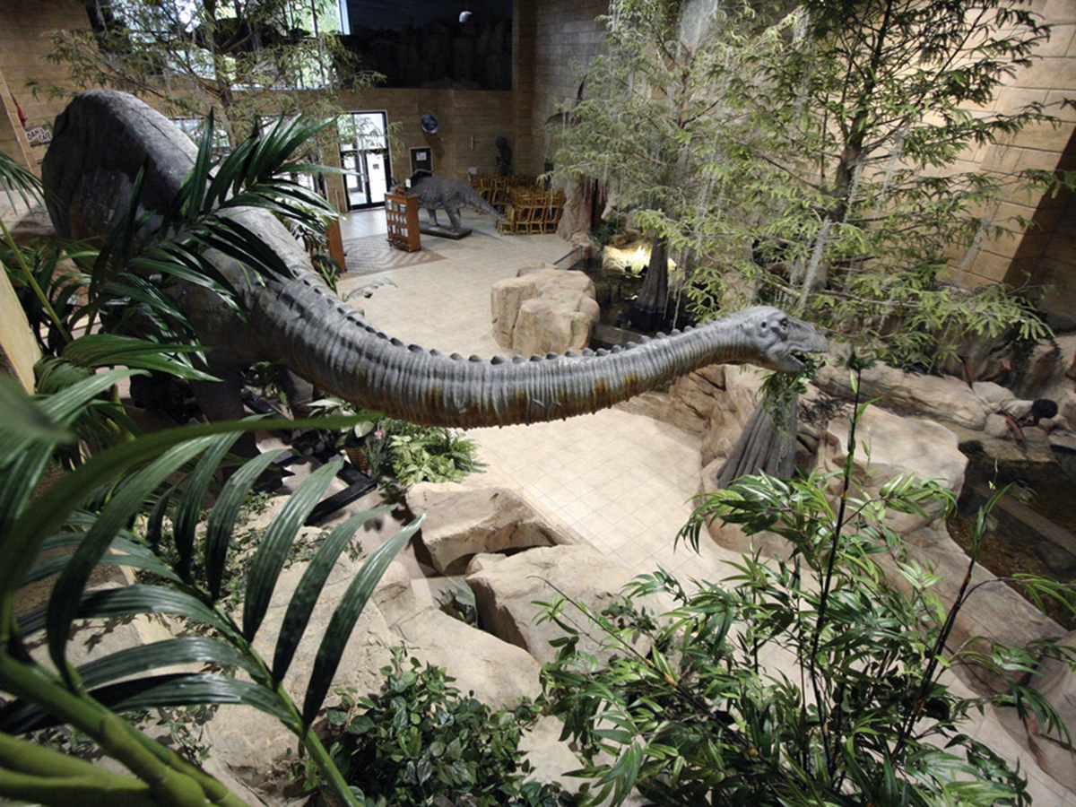
Creation Museum

Slide 8
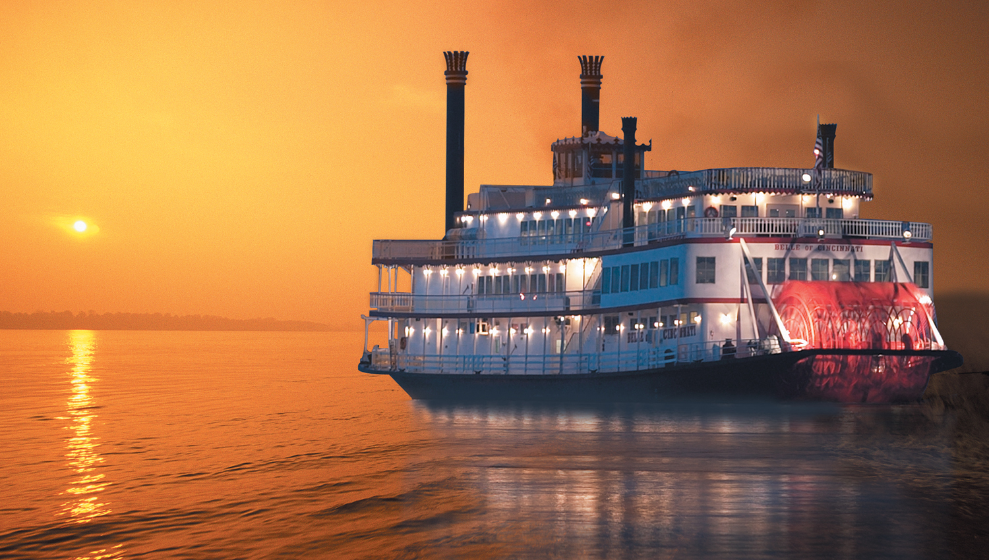
Belle of Cincinnati

Slide 9
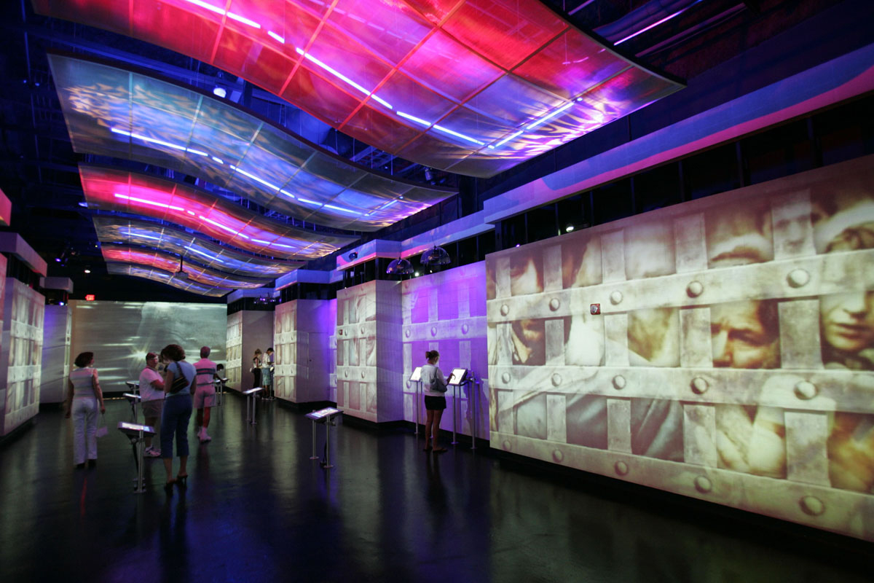
National Underground Railroad Freedom Center

Slide 10
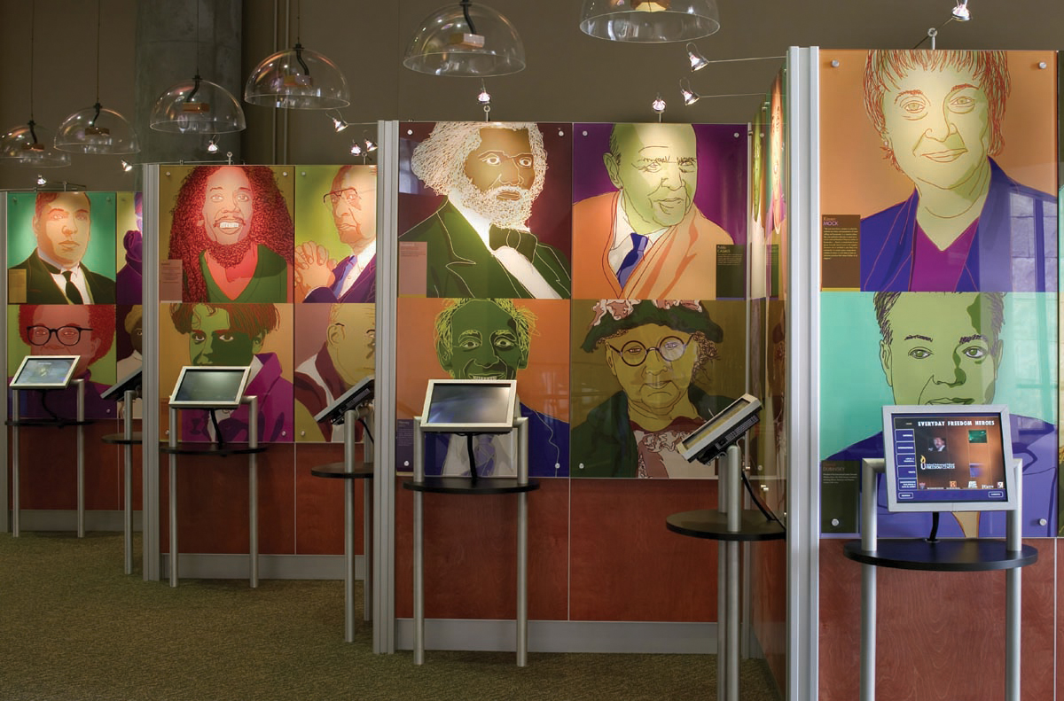

Slide 11
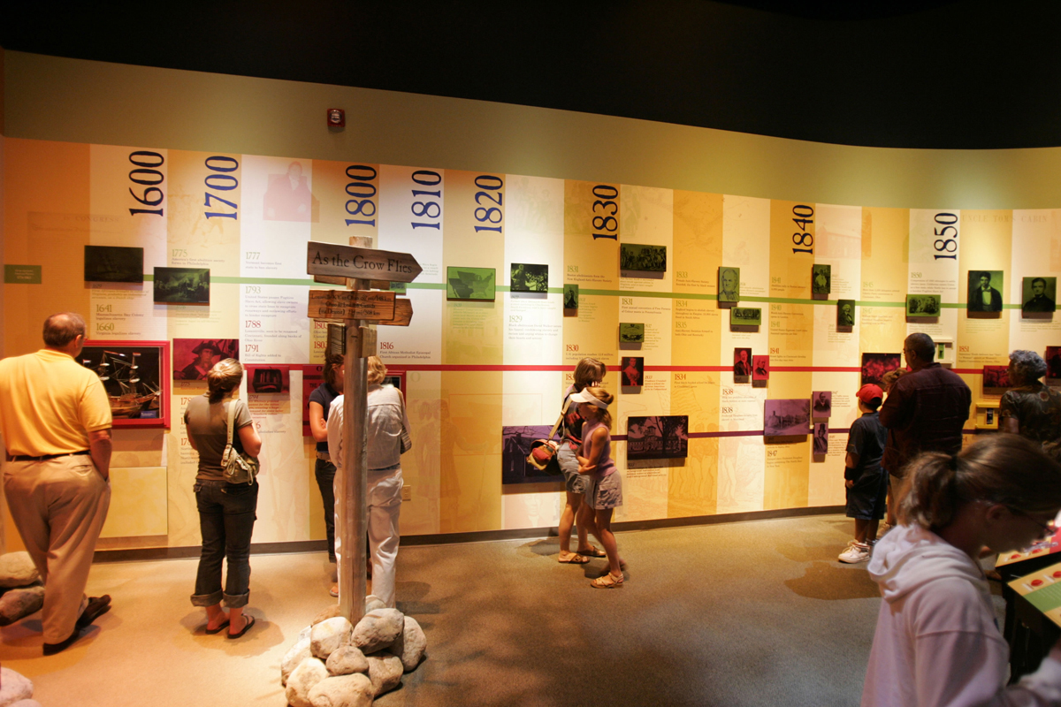

Slide 12
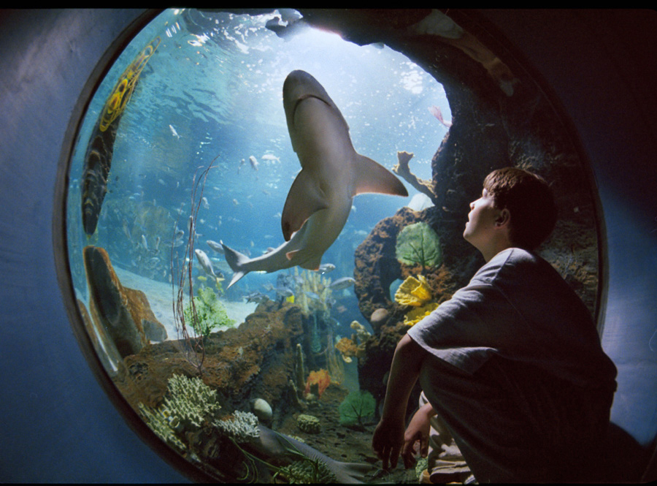
Newport Aquarium

Slide 13
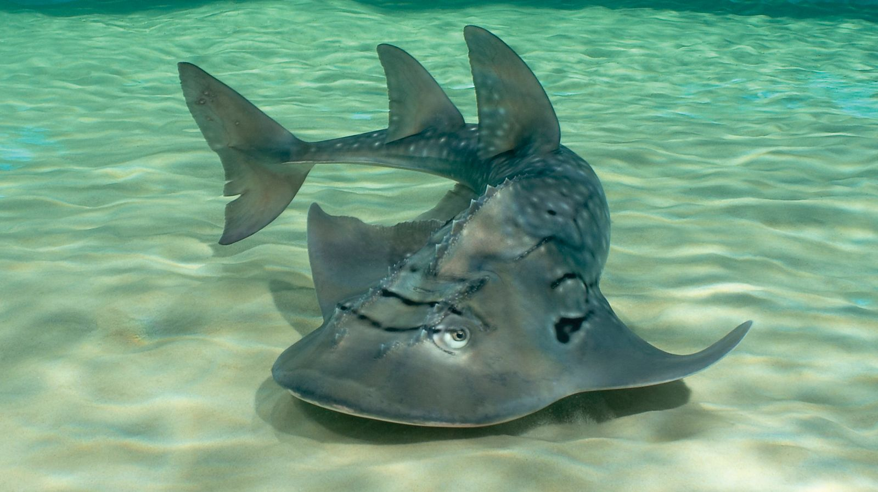
Ohhhh!!! Scary Guy!

Slide 14
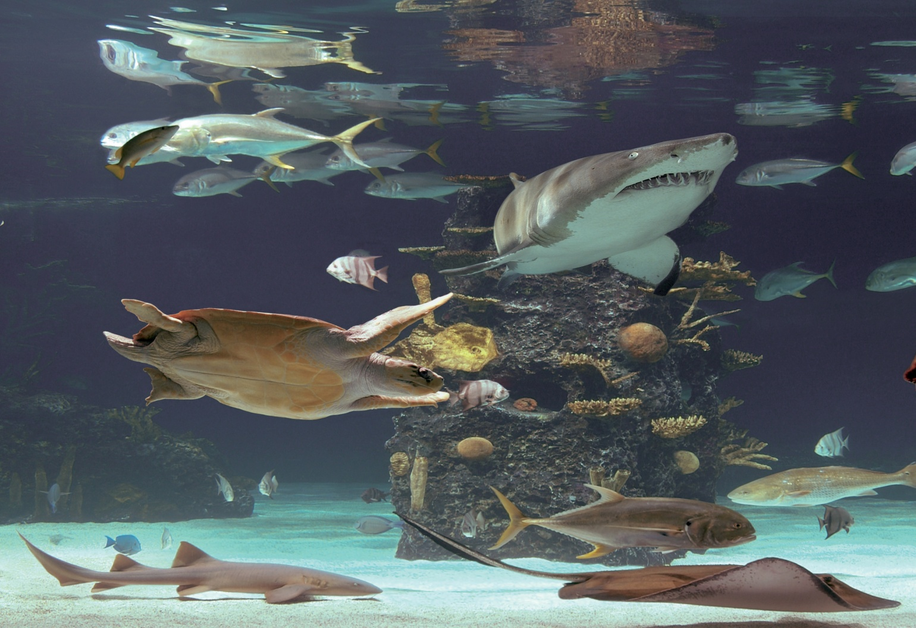
You could go for a swim!!

Slide 15
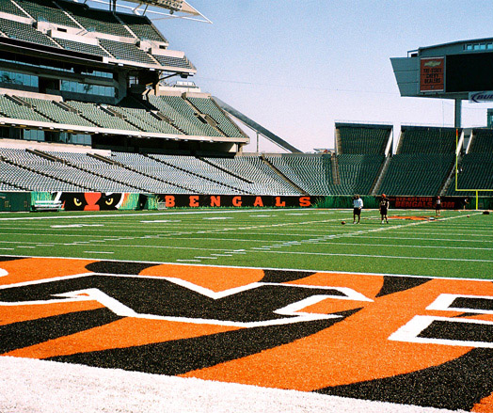
Or maybe take in a ball game

Slide 16
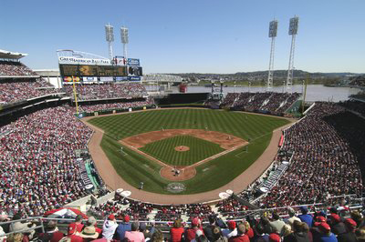
or three!!!

Slide 17
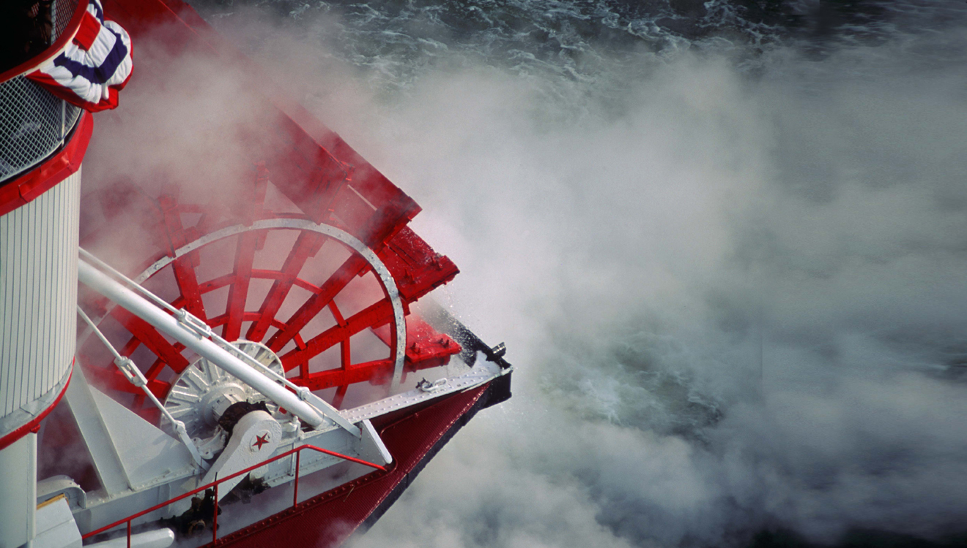
Or ride a paddle boat.

Slide 18
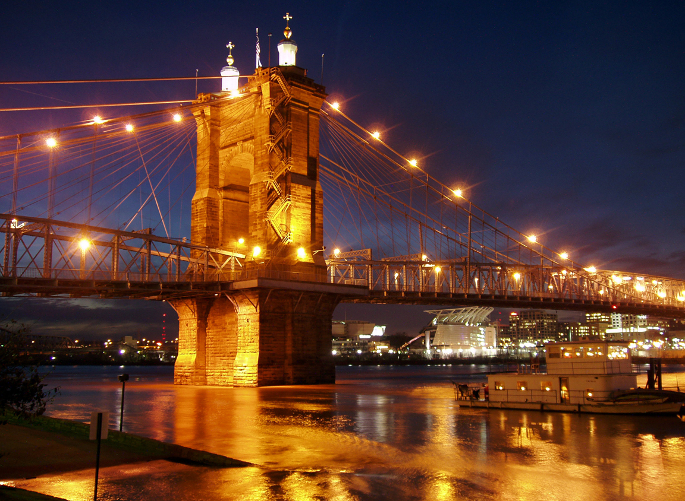

Slide 19
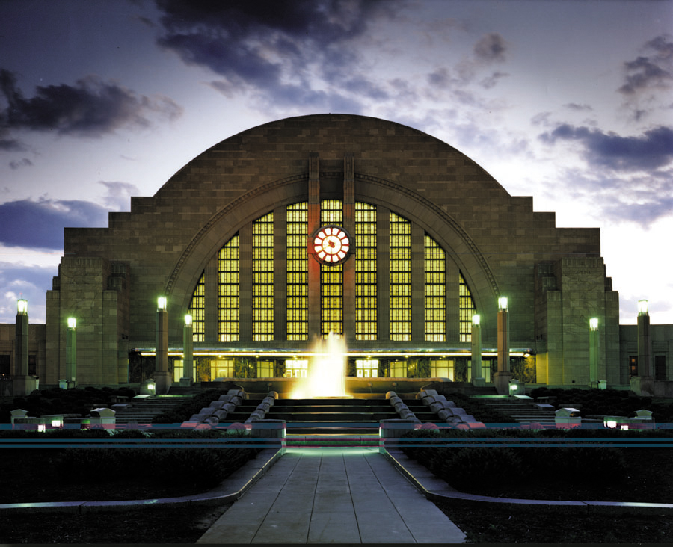
Don’t forget beautiful Union Terminal!

Slide 20
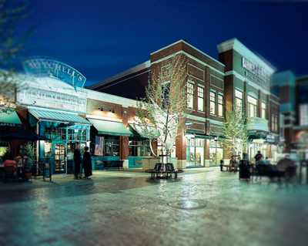
Get in a little shopping!!!

Slide 21
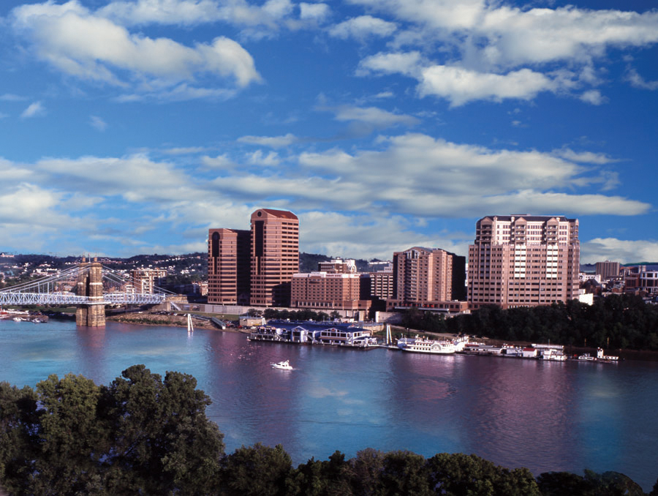
Enjoy the beauty of the area

Slide 22
And Best of All
Take in the 2024 National FCE Annual Conference.
Workshops
Hearth Fire and FCL Sessions
General Sessions
Service Project
Tours
Great Food
Alumni fundraiser
FUN! FUN!! FUN!!!
(This is the perfect opportunity to visit Headquarters and meet Judy Jones, our Executive Secretary.)

Slide 23
Please join us for another educational and fun filled conference!!!
National FCE
Annual Conference
July 25-28, 2024
Erlanger, Kentucky

